Slide 1

ITS30705 CHAPTER 3: OPERATOR, FUNCTION, PARAMETER, RETURN

Slide 2
CONTENT
Operator
Type Casting
Function
Parameter
Return

Slide 3
Operator – relational operator
Used to compare two values
Operator | Name | Example
== | Equal | x == y
!= | Not equal | x != y
> | Greater than | x > y
< | Less than | x < y
>= | Greater than or equal to | x >= y
<= | Less than or equal to | x <= y

Slide 4
Operator – logical operator
Used to combine conditional statements
Operator | Description | Example
and | Returns True if both statements are true | x > 5 and x < 10
or | Returns True if one of the statements is true | x < 5 or x < 10
not | Reverse the results, returns False if the result is True | not (x > 5 and x < 10)

Slide 5
OPERATOR – IDENTITY OPERATOR
Used to compare the objects, not if they are equal, but if they are actually the same object, with the same memory location.
Operator | Description | Example
is | Returns True if both variables are the same object | x is y
is not | Returns True if both variables are not the same object | x is not y

Slide 6
Python’s math class
Method name | Description
math.ceil(value) | rounds up
math.floor(value) | rounds down
math.log(value, base) | logarithm
math.sqrt(value) | square root
math.sinh(value) math.cosh(value) math.tanh(value) | sine/cosine/tangent of an angle in radians
math.degrees(value) math.radians(value) | convert degrees to radians and back
To use this function, it is necessary, to import math

Slide 7
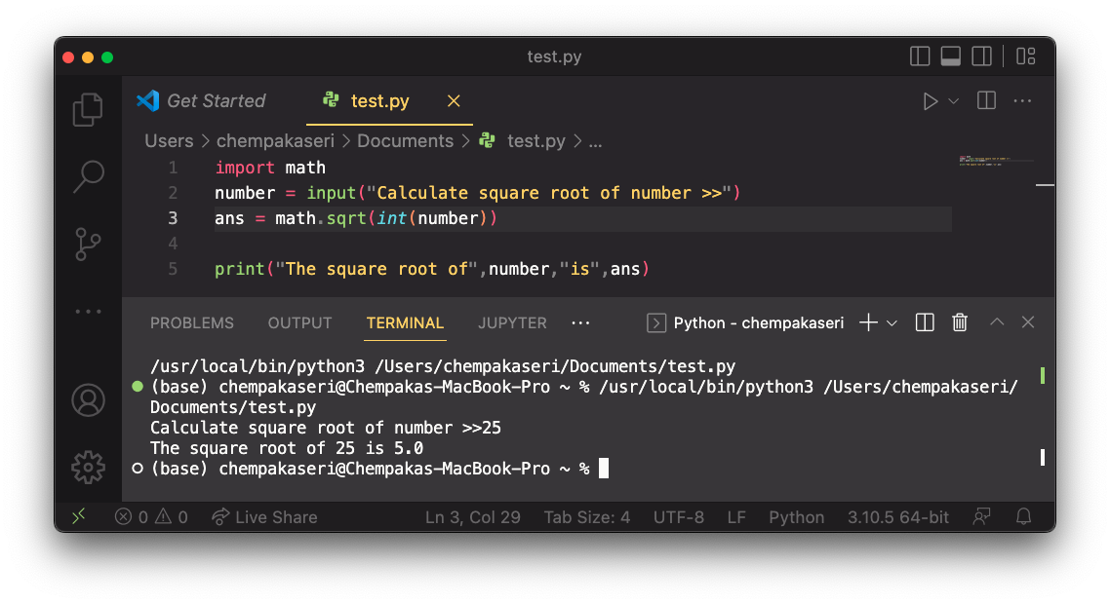
Python’s math class

Slide 8
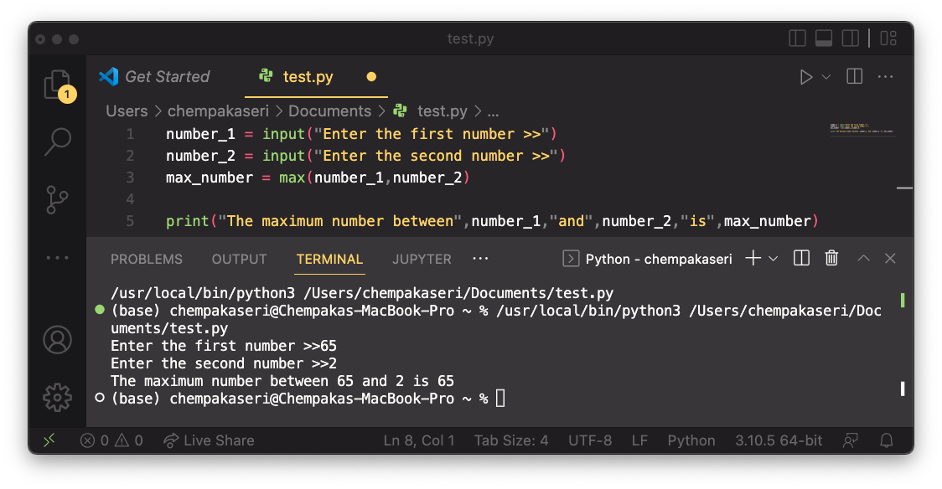
Python’s math class
Function name | Description
abs(value) | absolute value
min(value1, value2) | smaller of two values
max(value1, value2) | larger of two values
round(value) | nearest whole number

Slide 9
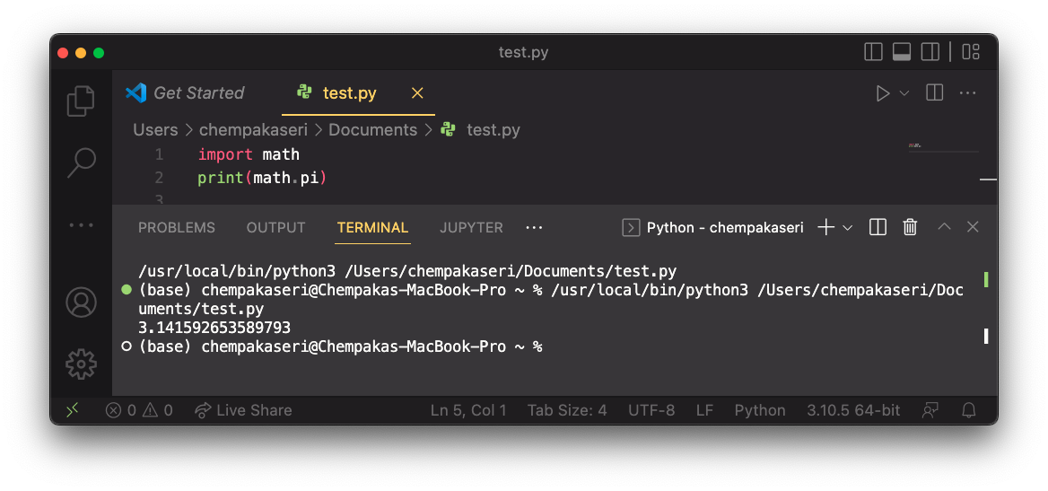
Python’s math class
Constant | Description
e | 2.7182818...
pi | 3.1415926...

Slide 10
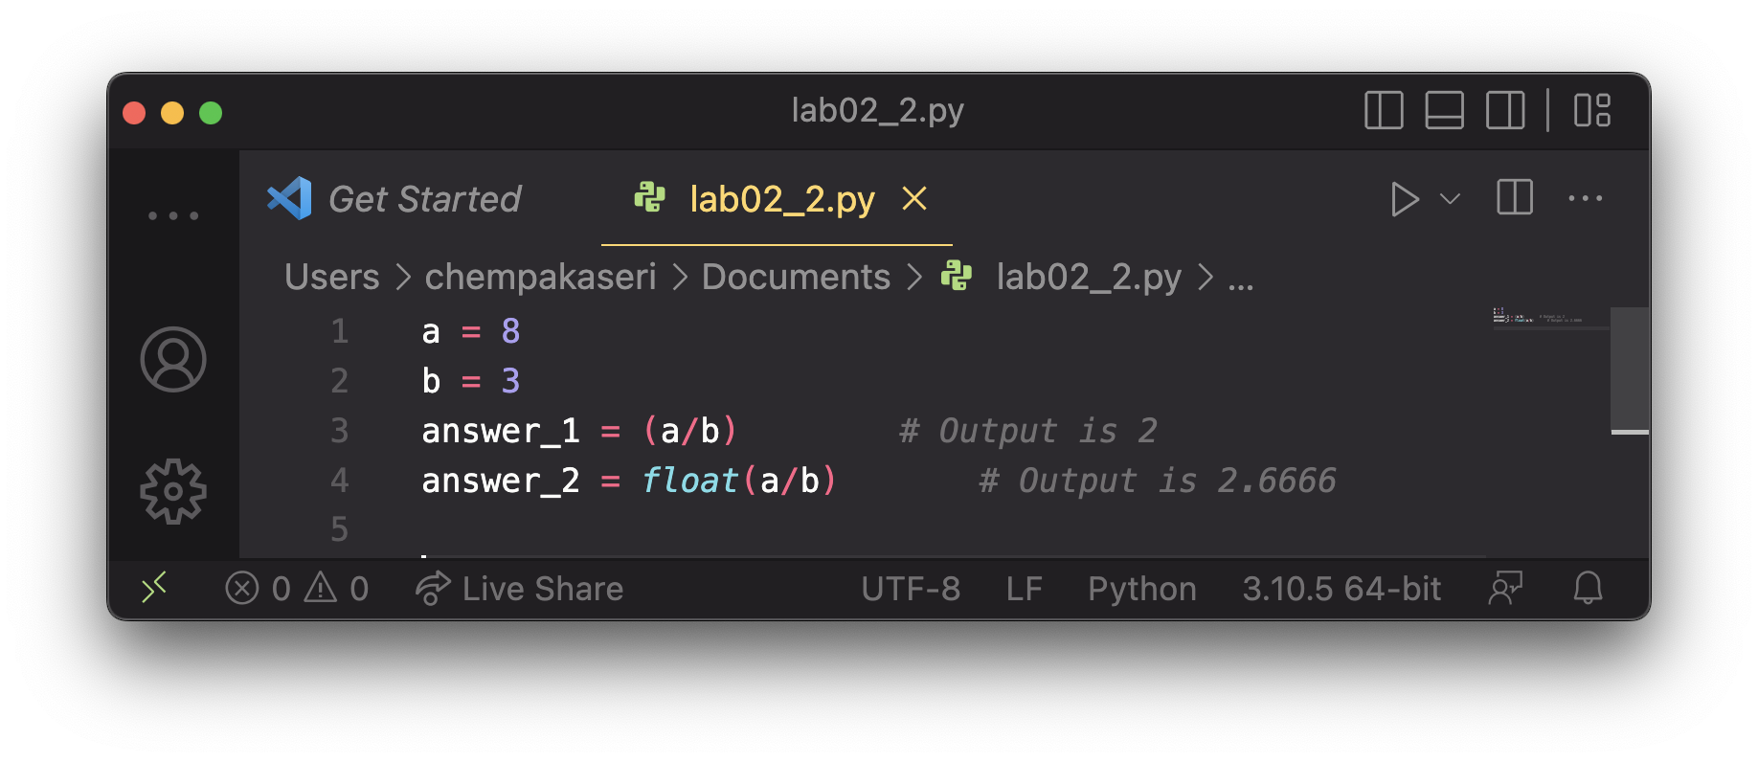
TYPE CASTING
Sometimes, it is convenient to convert data data from one type to another type. For example, you may want to treat the integer as a float during a computation.
Type casting takes a value of one type and produces a value of another type
Example:

Slide 11
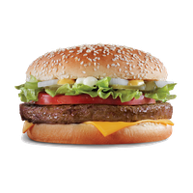
FUNCTIONS
As programs get longer, we want to keep the programs organized.

Slide 12
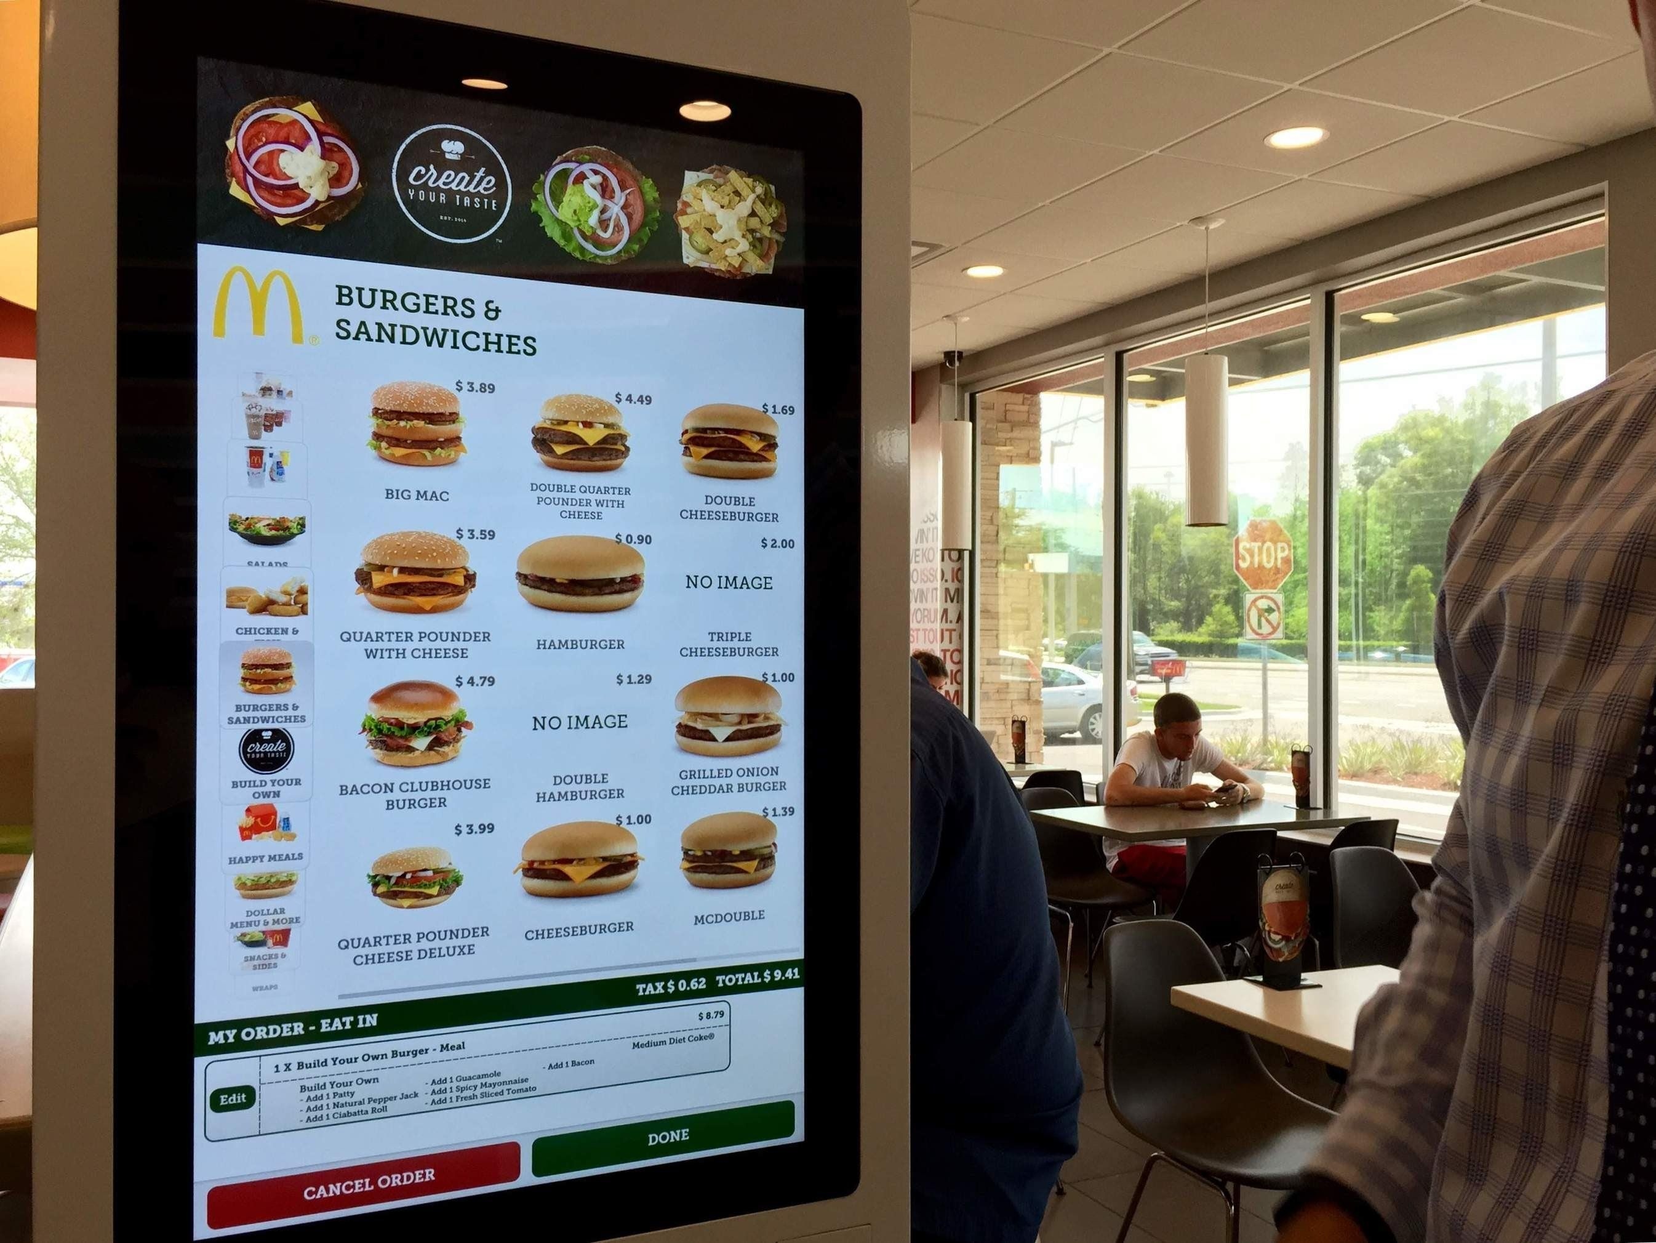
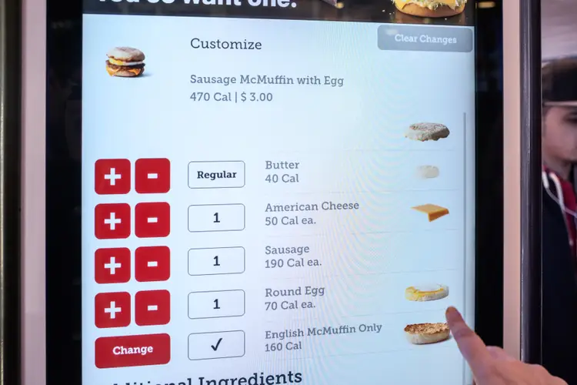
FUNCTIONS

Slide 13
FUNCTIONS
Algorithm: A list of steps for solving a problem
Example algorithm: ”Bake sugar cookies”
Mix the dry ingredients
Cream the butter and sugar
Beat in the eggs
Stir in the dry ingredients
Set the oven temperature
Set the timer for 10 minutes
Place the cookies into the oven
….

Slide 14
PROBLEM WITH ALGORITHM
Lack of structure: Many steps, tough to follow
Redundancy: Consider making a double batch

Slide 15
Structured algorithm
Split into coherent tasks
Make the batter
Mix the dry ingredients
Cream the butter and sugar
Beat in the eggs
Stir in the dry ingredients
2. Bake the cookies
Set the oven temperature
Set the timer for 10 minutes
Place the cookies into the oven
Allow the cookies to bake
3. Decorate the cookies
Mix the ingredients for the frosting
…

Slide 16
Removing redundancy
A well-structures algorithm can describe repeated tasks with less redundancy
Make the cookie batter
Mix the dry ingredients
…
2A Bake the cookies (First batch)
Set the oven temperature
Set the timer for 10 minute
….
2B Bake the cookies (Second batch)
Repeat step 2A
Decorate the cookies
…

Slide 17
FUNCTION
Function: A named group of statements
Denotes the structure of a program
Eliminates redundancy by code reuse
Procedural decomposition
Dividing a problem into functions
Writing a function is like adding a new command to Python
Function A
Statement
Statement
Statement
Function B
Statement
Statement
Statement
Function C
Statement
Statement

Slide 18
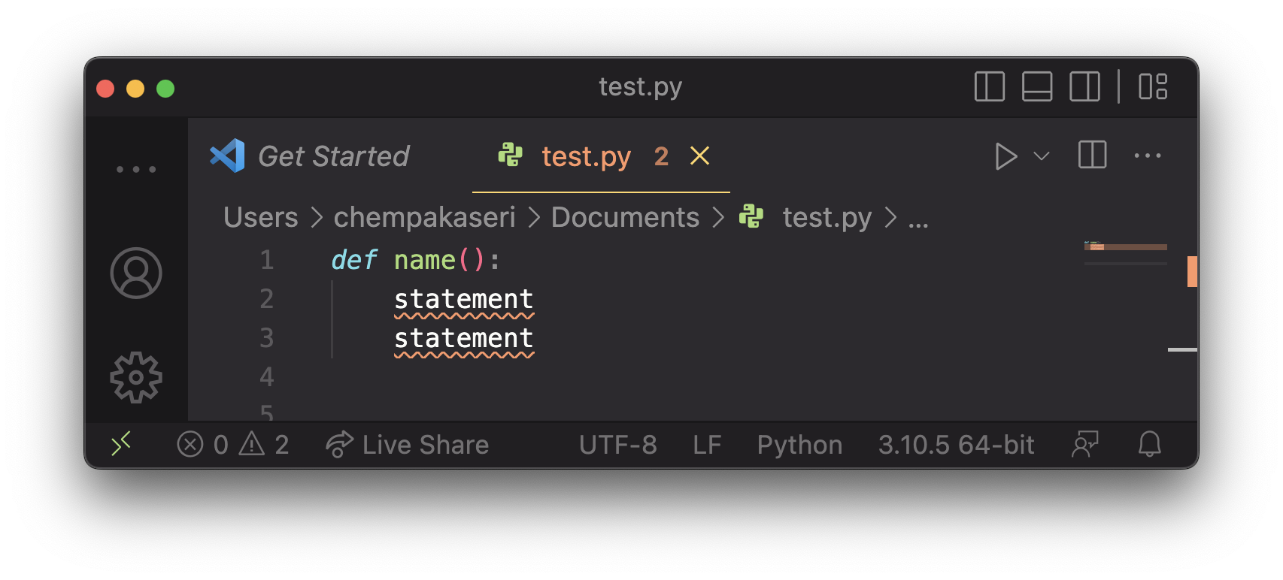
FUNCTION - Declare
Gives your function a name so that it can be activated
Syntax:

Slide 19
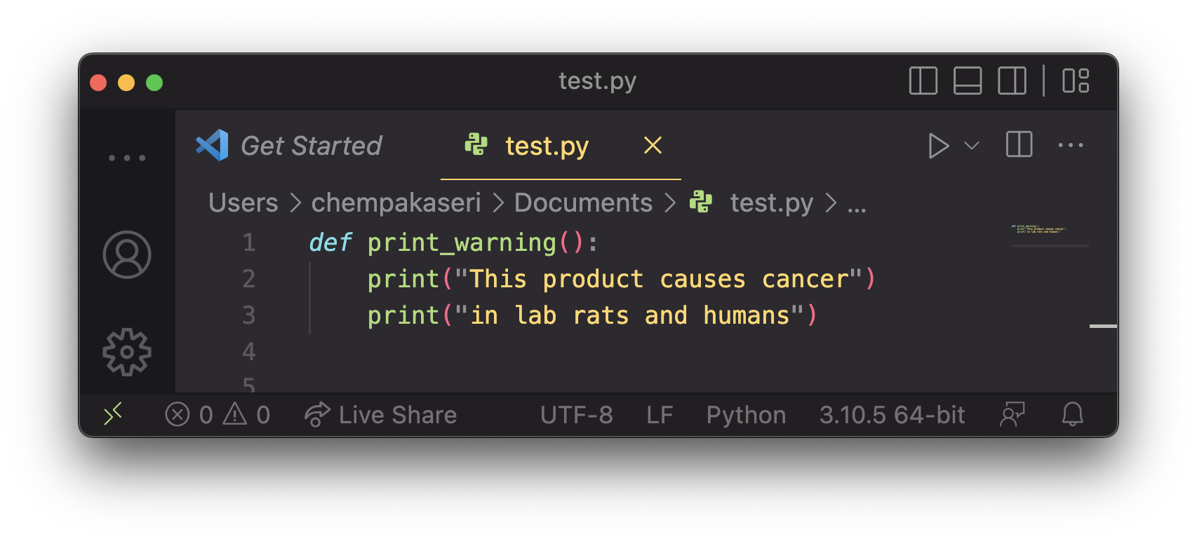
FUNCTION - Declare
Example:

Slide 20
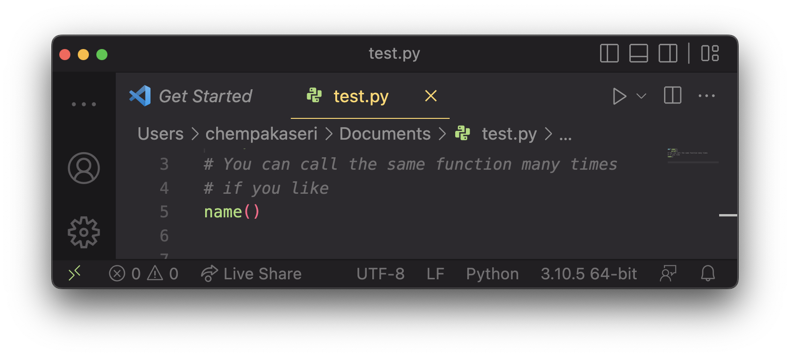
Function - calling
Executes the function’s code
Syntax:

Slide 21
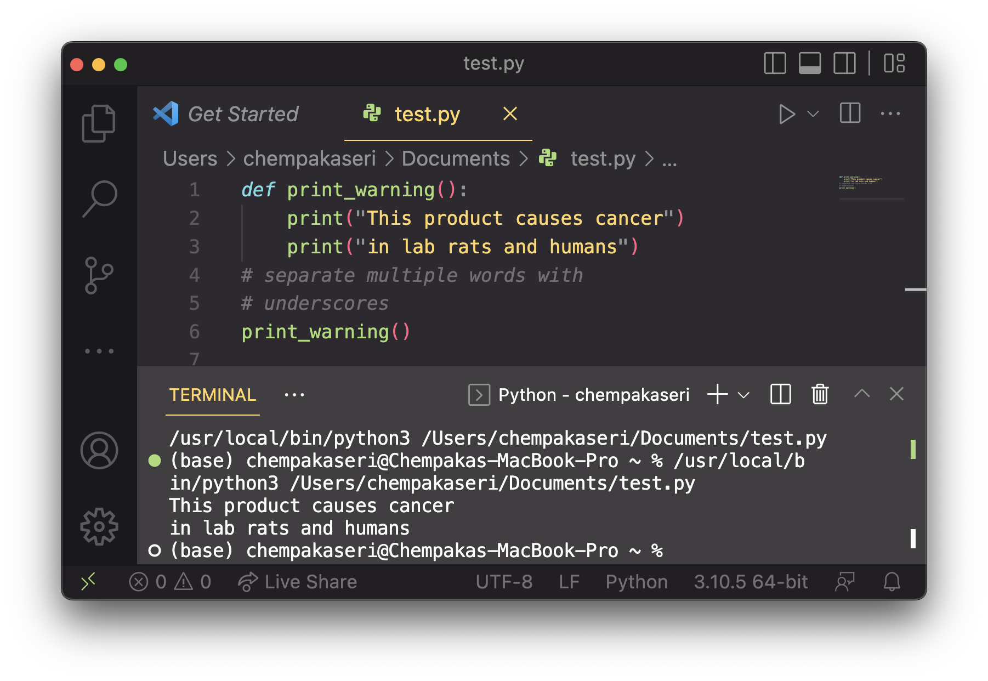
Function - calling
Example:

Slide 22
USING FUNCTIONS
Design (think about) the algorithm
Look at the structure, and which commands are repeated.
Decide what are the important overall tasks
Declare (write down) the functions
Arrange statements into groups and give each group a name
Call (run) the function

Slide 23
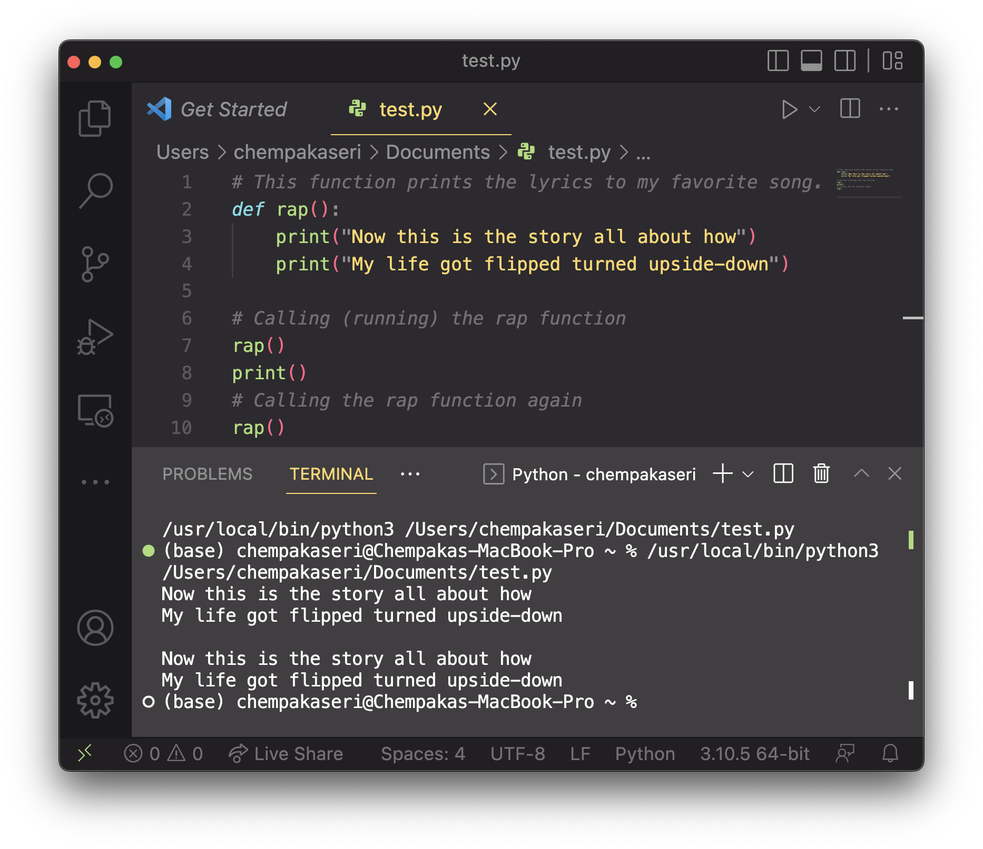
Program with function

Slide 24
PARAMETER
Parameter: A value passed to a function by its caller.
Instead of turtle_equal, turtle_v, write turtle to draw any turtle.
When declaring the function, we will state that it requires a parameter for the number of stars
When calling the function, we will specify how many stars to draw.
"="
/= =\/')
/= = =\/
ou ou
main
turtle
"v"
turtle
/v v\/')
/v v v\/
ou ou

Slide 25
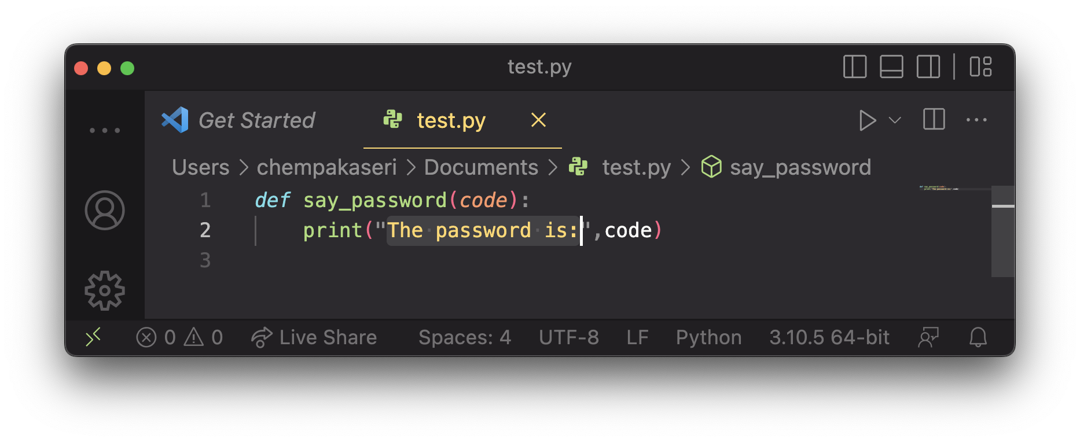
PARAMETER – DECLARATION
Stating that a function requires a parameter in order to run
Syntax:
Example:
When say_password is called, the caller must specify the code to print.
def <name> (<name>):
<statement>(s)

Slide 26
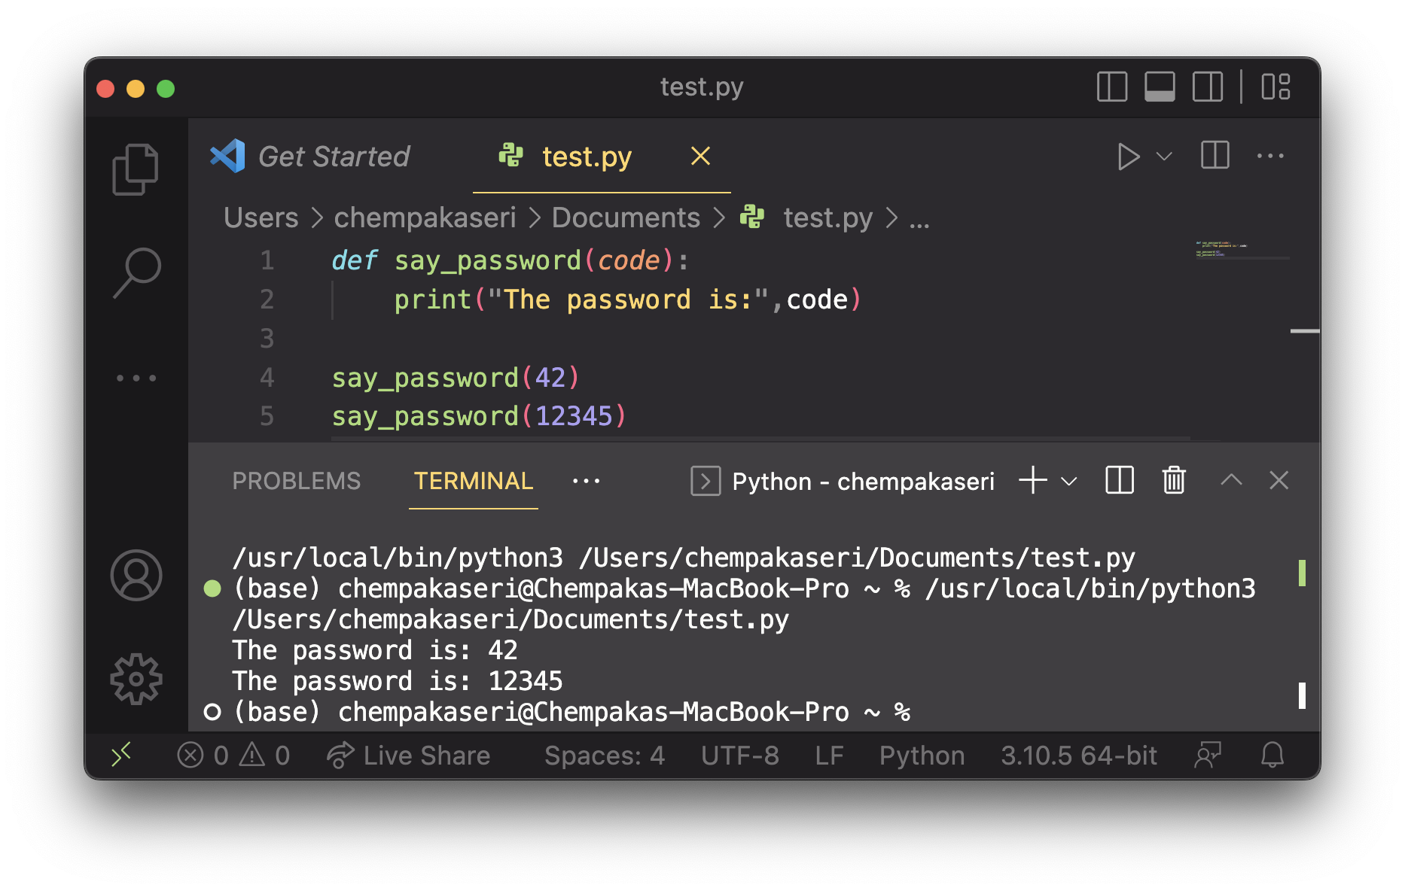
PARAMETER - Calling
Calling a function and specifying values for its parameters
Example:
<name> (<expression>)

Slide 27
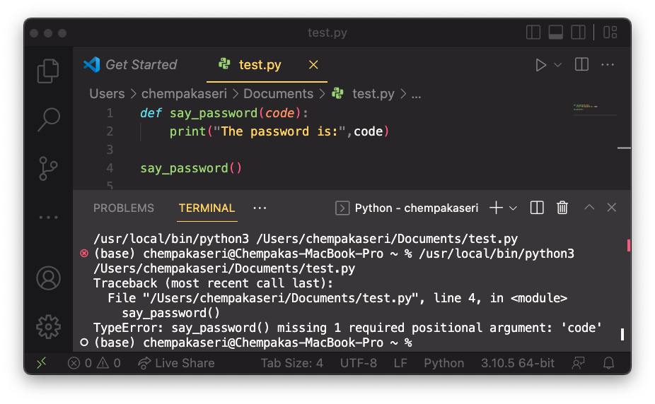
COMMON ERRORS
If a function accepts a parameter, it is illegal to call it without passing any value for that parameter.

Slide 28
Multiple parameter
A function can accept multiple parameters that is separate by (,)
When you calling the function, you must pass values for each parameter.
Syntax:
def <name>(<name>, ..., <name>):
<statement>(s)

Slide 29
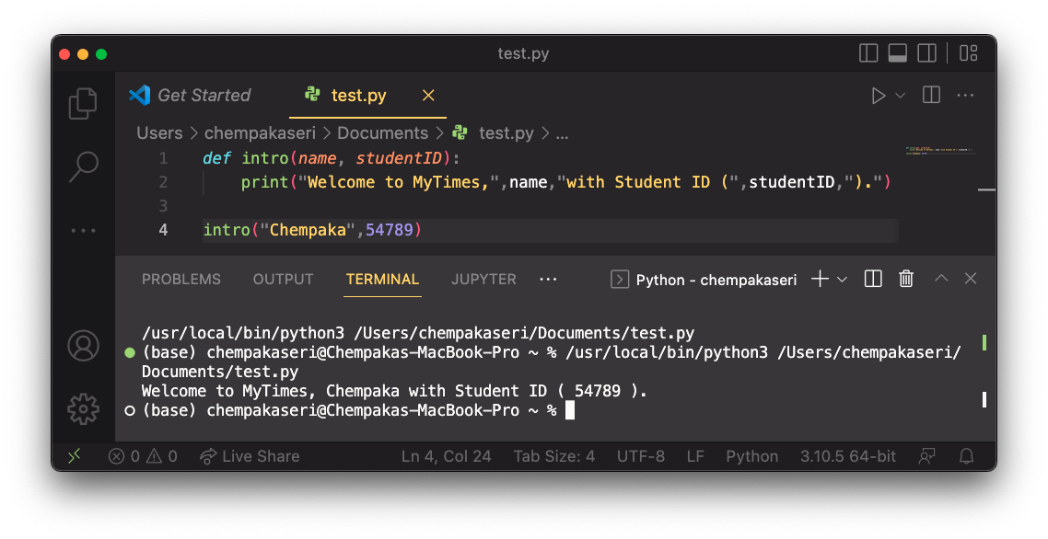
Multiple parameter - declaration
Example:

Slide 30
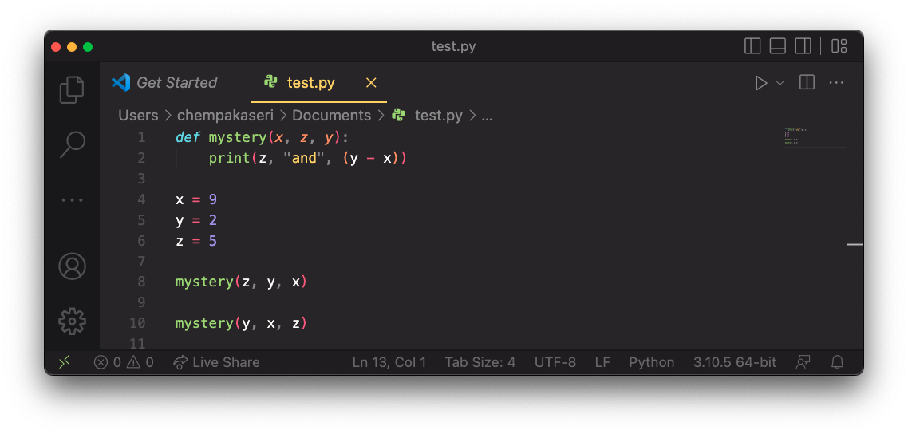
PARAMETER – “MYSTERY PROBLEM”

Slide 31
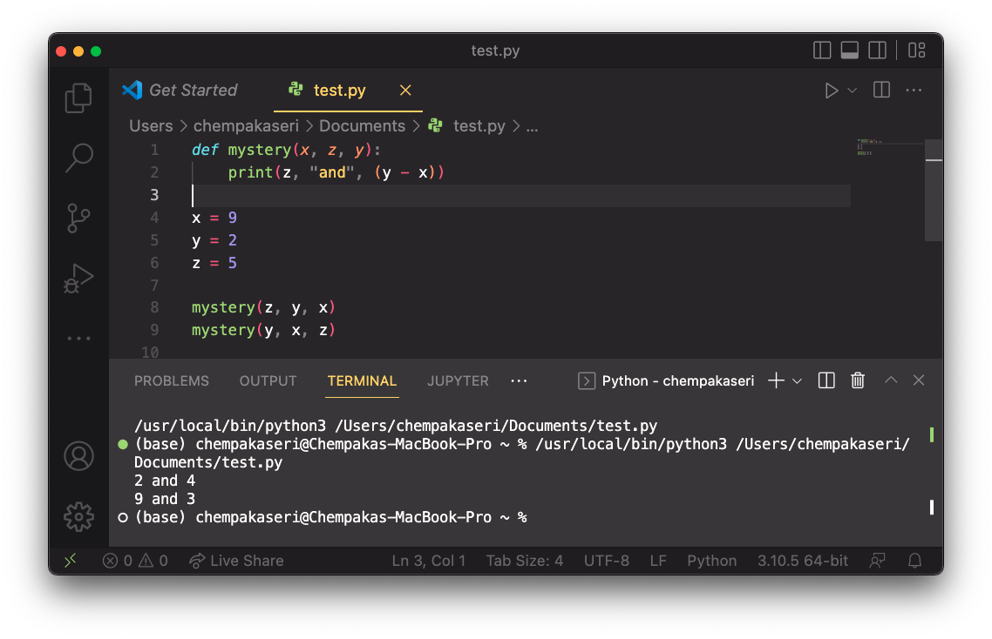
PARAMETER – “MYSTERY PROBLEM”

Slide 32
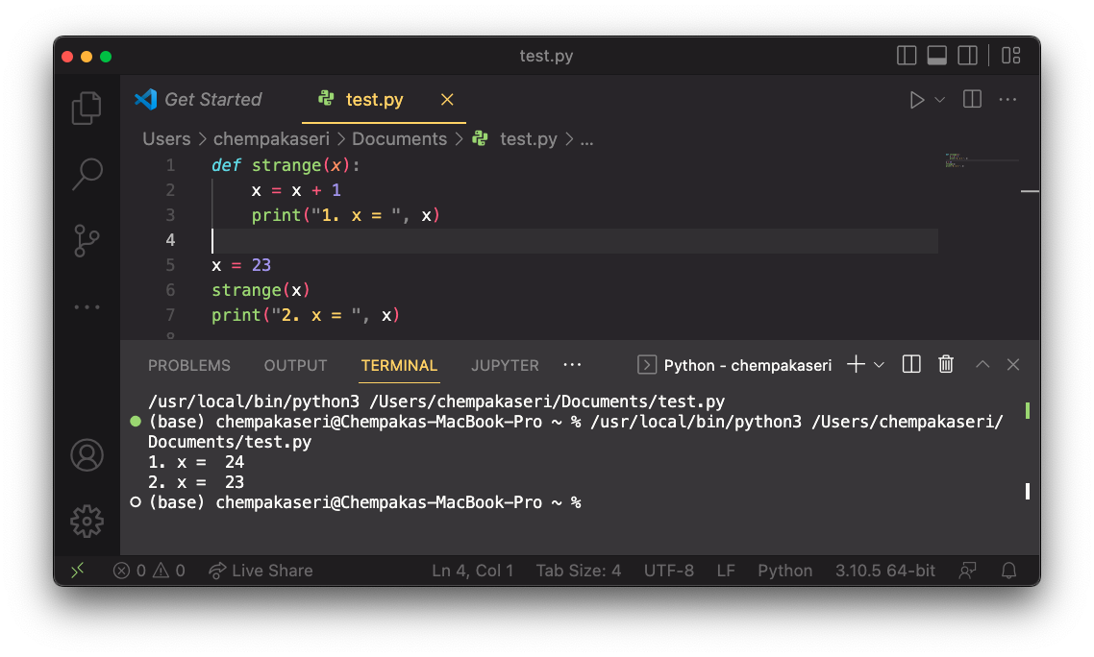
Value semantics
Value semantics: When numbers and strings are passed as parameters, their values are copied.
Hence, modifying the parameter will not affect the variable passed in.

Slide 33
RETURN
Return: to send out a value as the result of a function
Return values send information out from a function to its caller. A call to the function can be used as part of an expression.
Compare to parameters which send values into a function
-42
abs(-42)
42
main
2.71
3
math.ceil(2.71)

Slide 34
Returning a value
When Python reaches a return statement:
It evaluates the expression
It substitutes the return value in place of the call
It goes back to the caller and continues after the method call
Syntax:
def name(parameters):
statements
...
return expression

Slide 35
Return vs print
It might seem more useful for the math functions to print their results rather than returning them. Why is return preferred?
Answer: Returning is more flexible than printing

Slide 36
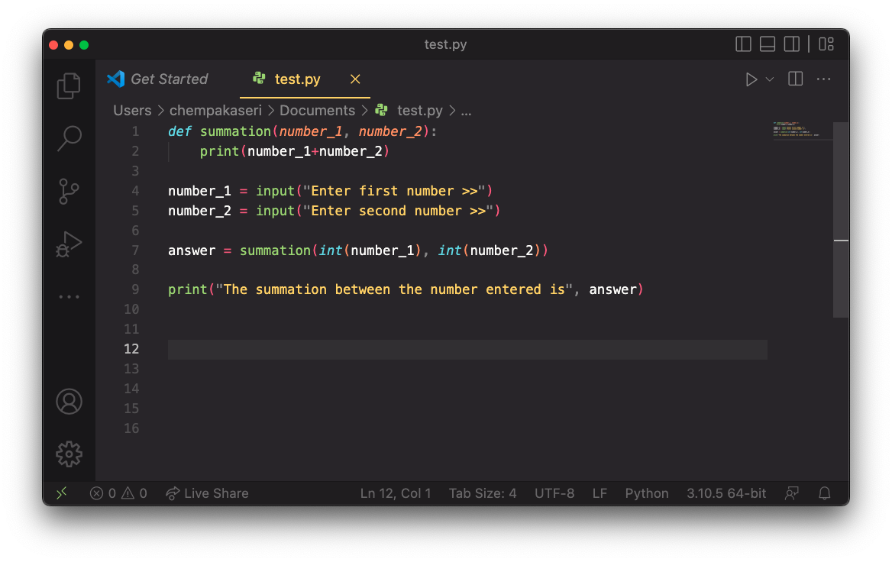
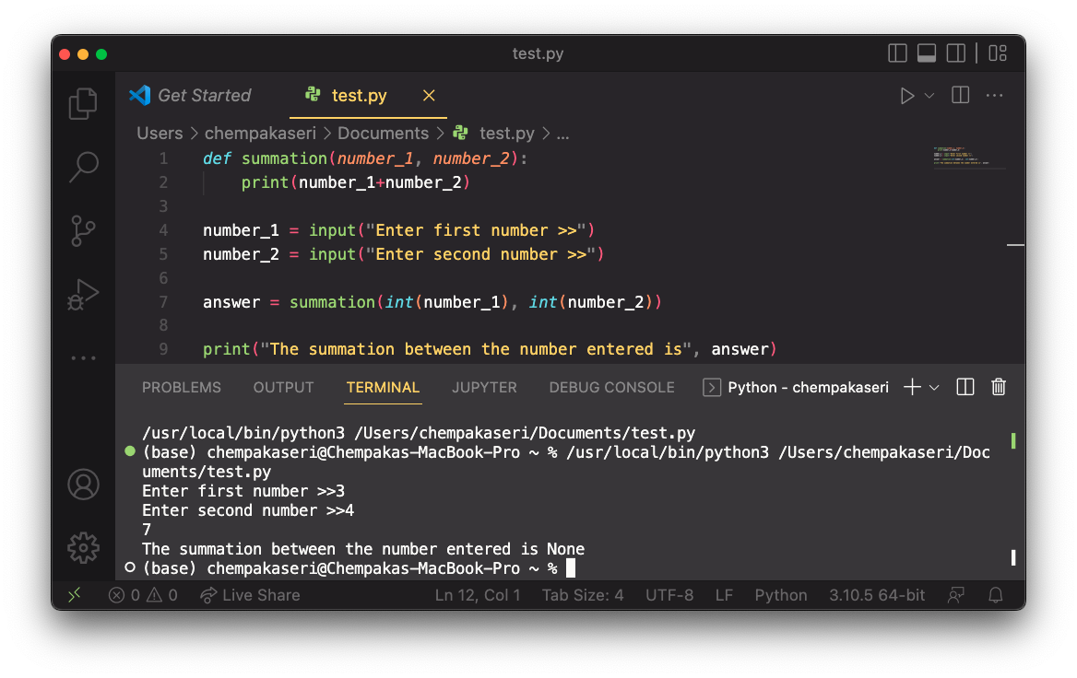
Return vs print

Slide 37
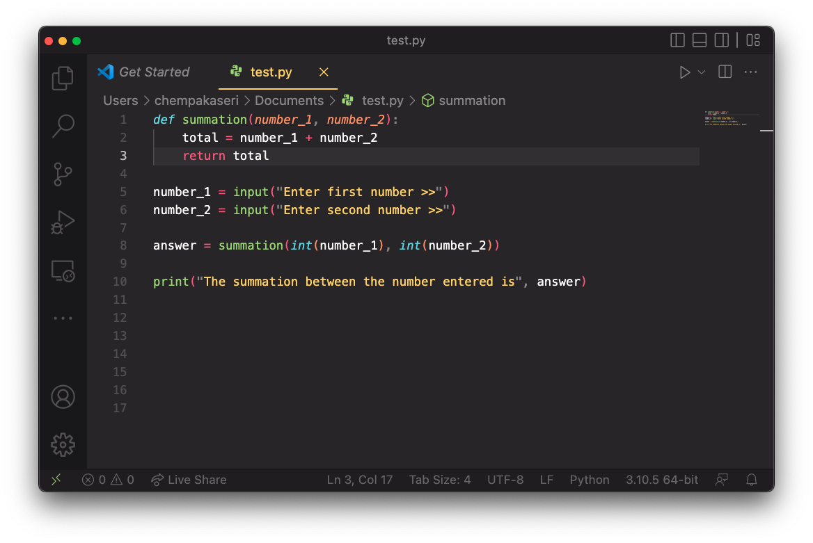
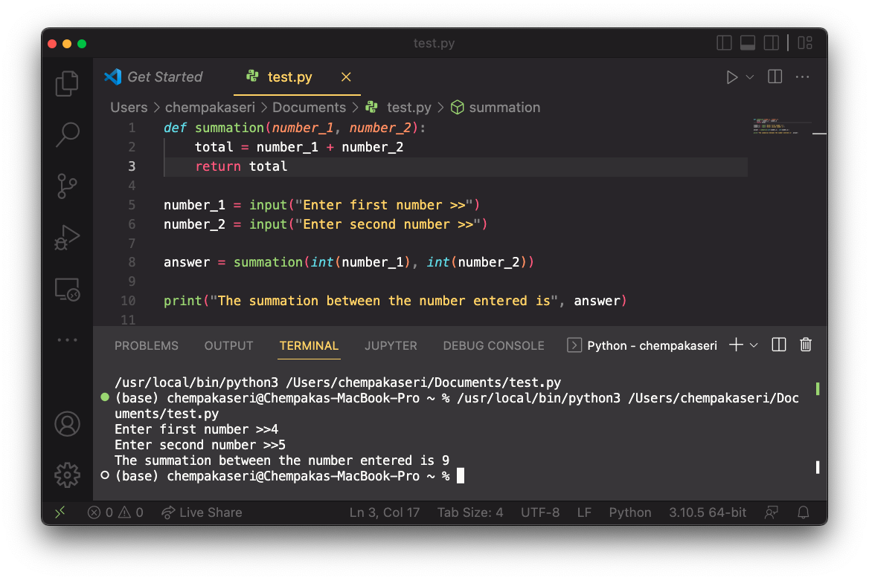
Return vs print

Slide 38
EXAMPLE – function & PARAMETER
Write a Python program that accept temperature in Fahrenheit. The input is passed to a function that convert the temperature in Fahrenheit to temperature in Celsius and return the temperature in Celsius to the main program and display the temperature in Celsius.

Slide 39
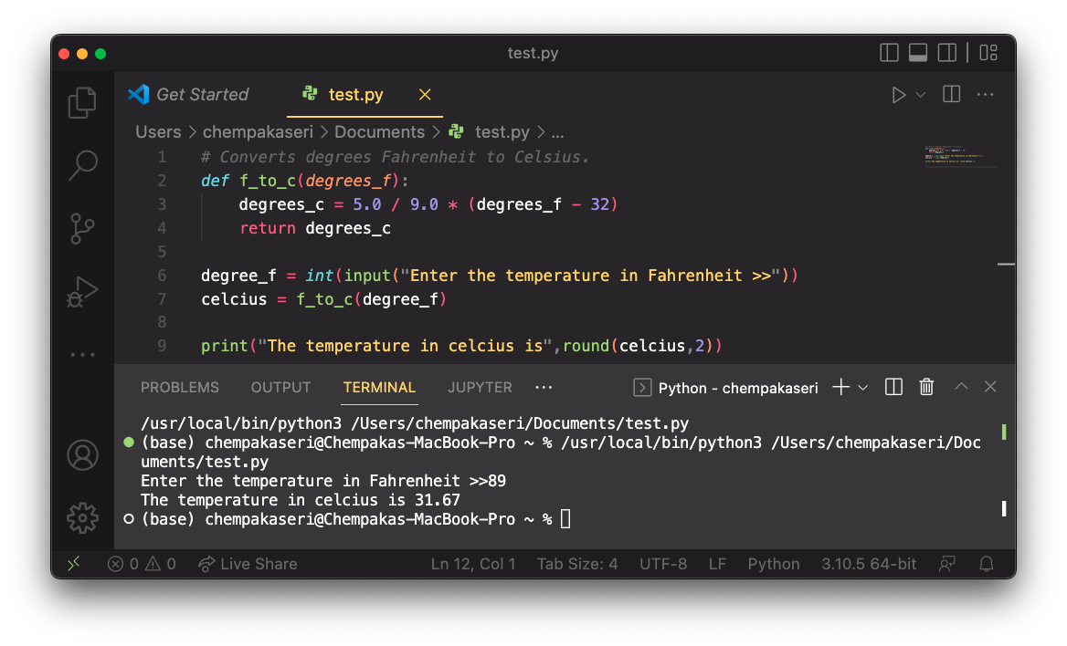
EXAMPLE – function & PARAMETER

Slide 40
Variable - scope and lifetime
Not all variable are accessible throughout the program and exist for the same amount of time.
A variable which is defined in the main body of a file is called a global variable.

Slide 41
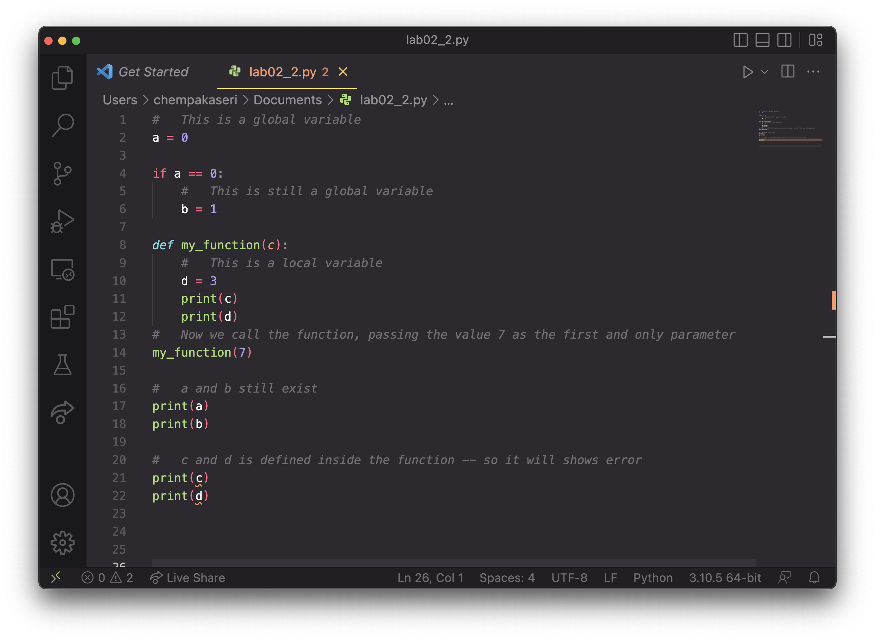

Slide 42
EXERCISE
Question 1
Write a program that accept two numbers as an input. The input is then pass to a function that calculate the summation of both number. The function will then return the summation of both number and display to the user.
def summation(number_1, number_2):
return number_1 + number_2
number_1 = int(input("Enter the first number >> "))
number_2 = int(input("Enter the second number >> "))
total = summation(number_1, number_2)
print("The summation of both number is", total)

Slide 43
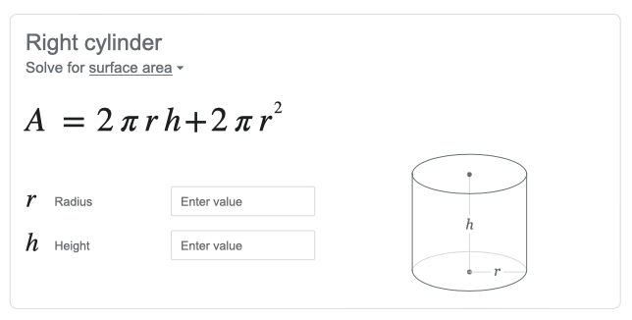
EXERCISE
Question 2
Write a program that accept radius and height of a cylinder. Both inputs are passed into a function that calculates the area of a cylinder. The function is then return the area of cylinder to the main function and display to the user.

Slide 44
